Slide 1
Natural Language Processing
Week 3

Slide 2
Good evening, everyone. Welcome to the live session.
Today, we will be practicing problems from the current week’s content.
We will wait 5 minutes for everyone to join in and start at 7:05 pm.

Slide 3
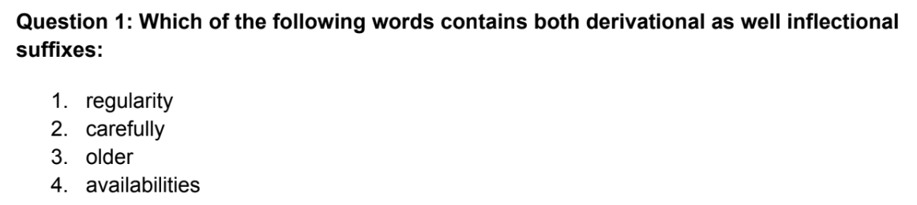

Slide 4
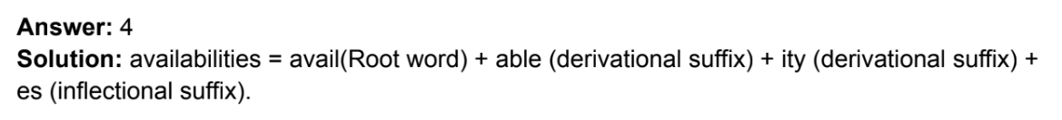
Solution

Slide 5
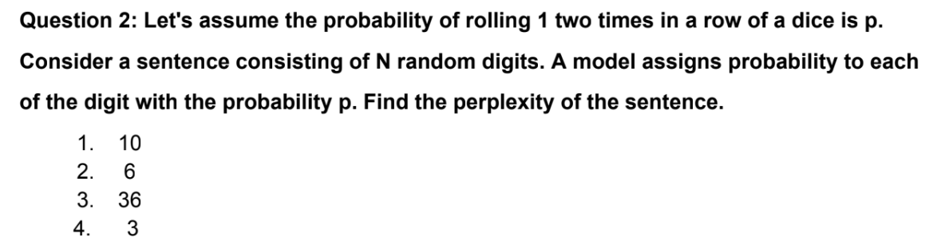

Slide 6
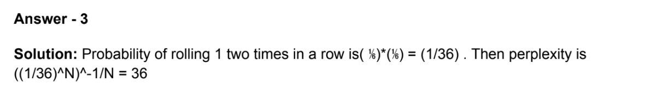
Solution

Slide 7
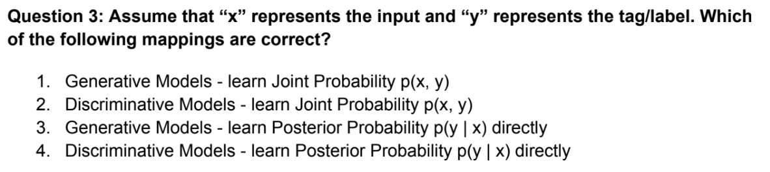

Slide 8

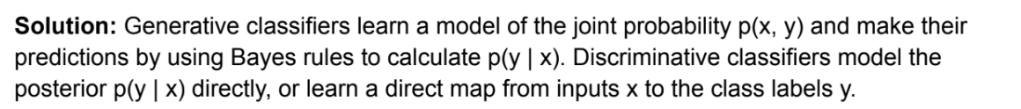
Solution

Slide 9
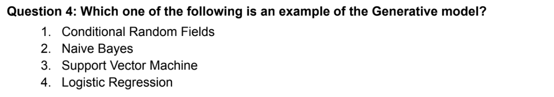

Slide 10
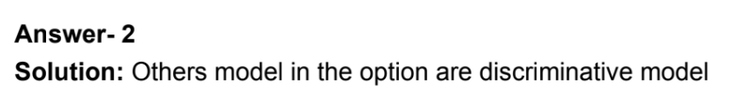
Solution

Slide 11
Question 5: Which of the following morphological process is true for motor+hotel →
motel?
1. Suppletion
2. Compounding
3. Blending
4. Clipping

Slide 12
Solution
Question 5: Which of the following morphological process is true for motor+hotel →motel?
1. Suppletion
2. Compounding
3. Blending
4. Clipping
Answer: 3
Solution: Blending combines parts of two different words.

Slide 13
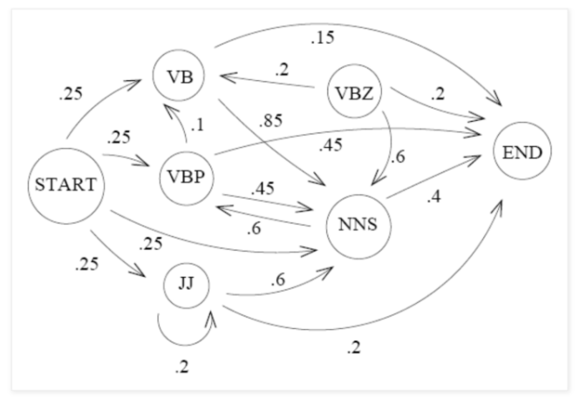
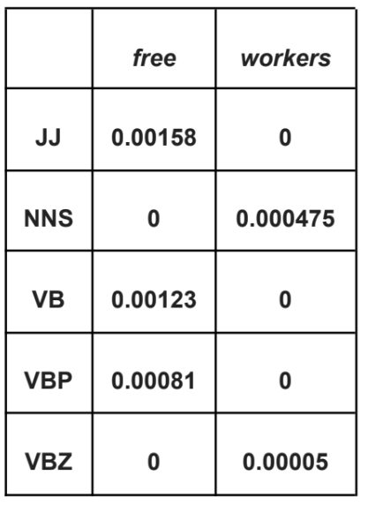
Question 6: Consider the HMM given below to solve the sequence labeling problem of POS tagging. With that HMM, calculate the probability that the sequence of words “free workers” will be assigned the following parts of speech;
VB NNS

Slide 14
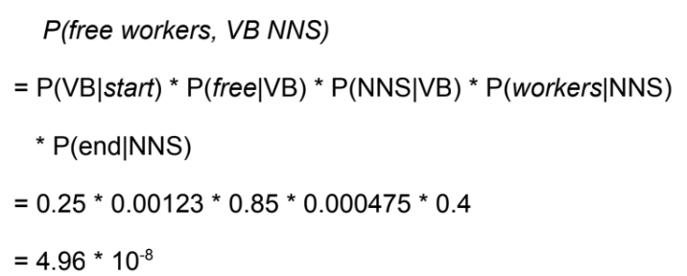
Solution

Slide 15
Question 7: Which of the following is/are true?
1. Only a few non-deterministic automation can be transformed into a deterministic one
2. Recognizing problem can be solved in linear time
3. Deterministic FSA might contain empty (ε) transition
4. There exist an algorithm to transform each automation into a unique equivalent
automation with the least no of states

Slide 16
Solution
Question 7: Which of the following is/are true?
1. Only a few non-deterministic automation can be transformed into a deterministic one
2. Recognizing problem can be solved in linear time
3. Deterministic FSA might contain empty (ε) transition
4. There exist an algorithm to transform each automation into a unique equivalent
automation with the least no of states
Answer: 2, 4
Solution:
Every non-deterministic automation can be transformed into a deterministic one. Deterministic FSA should not contain empty transition.

Slide 17
Question 8: Which of the following are an example of clipping?
1. brunch
2. gator
3. laser
4. ad

Slide 18
Solution
Question 8: Which of the following are an example of clipping?
1. brunch
2. gator
3. laser
4. ad
Answer: 2, 4
Solution: gator (alligator), ad (advertisement)

